Slide 1
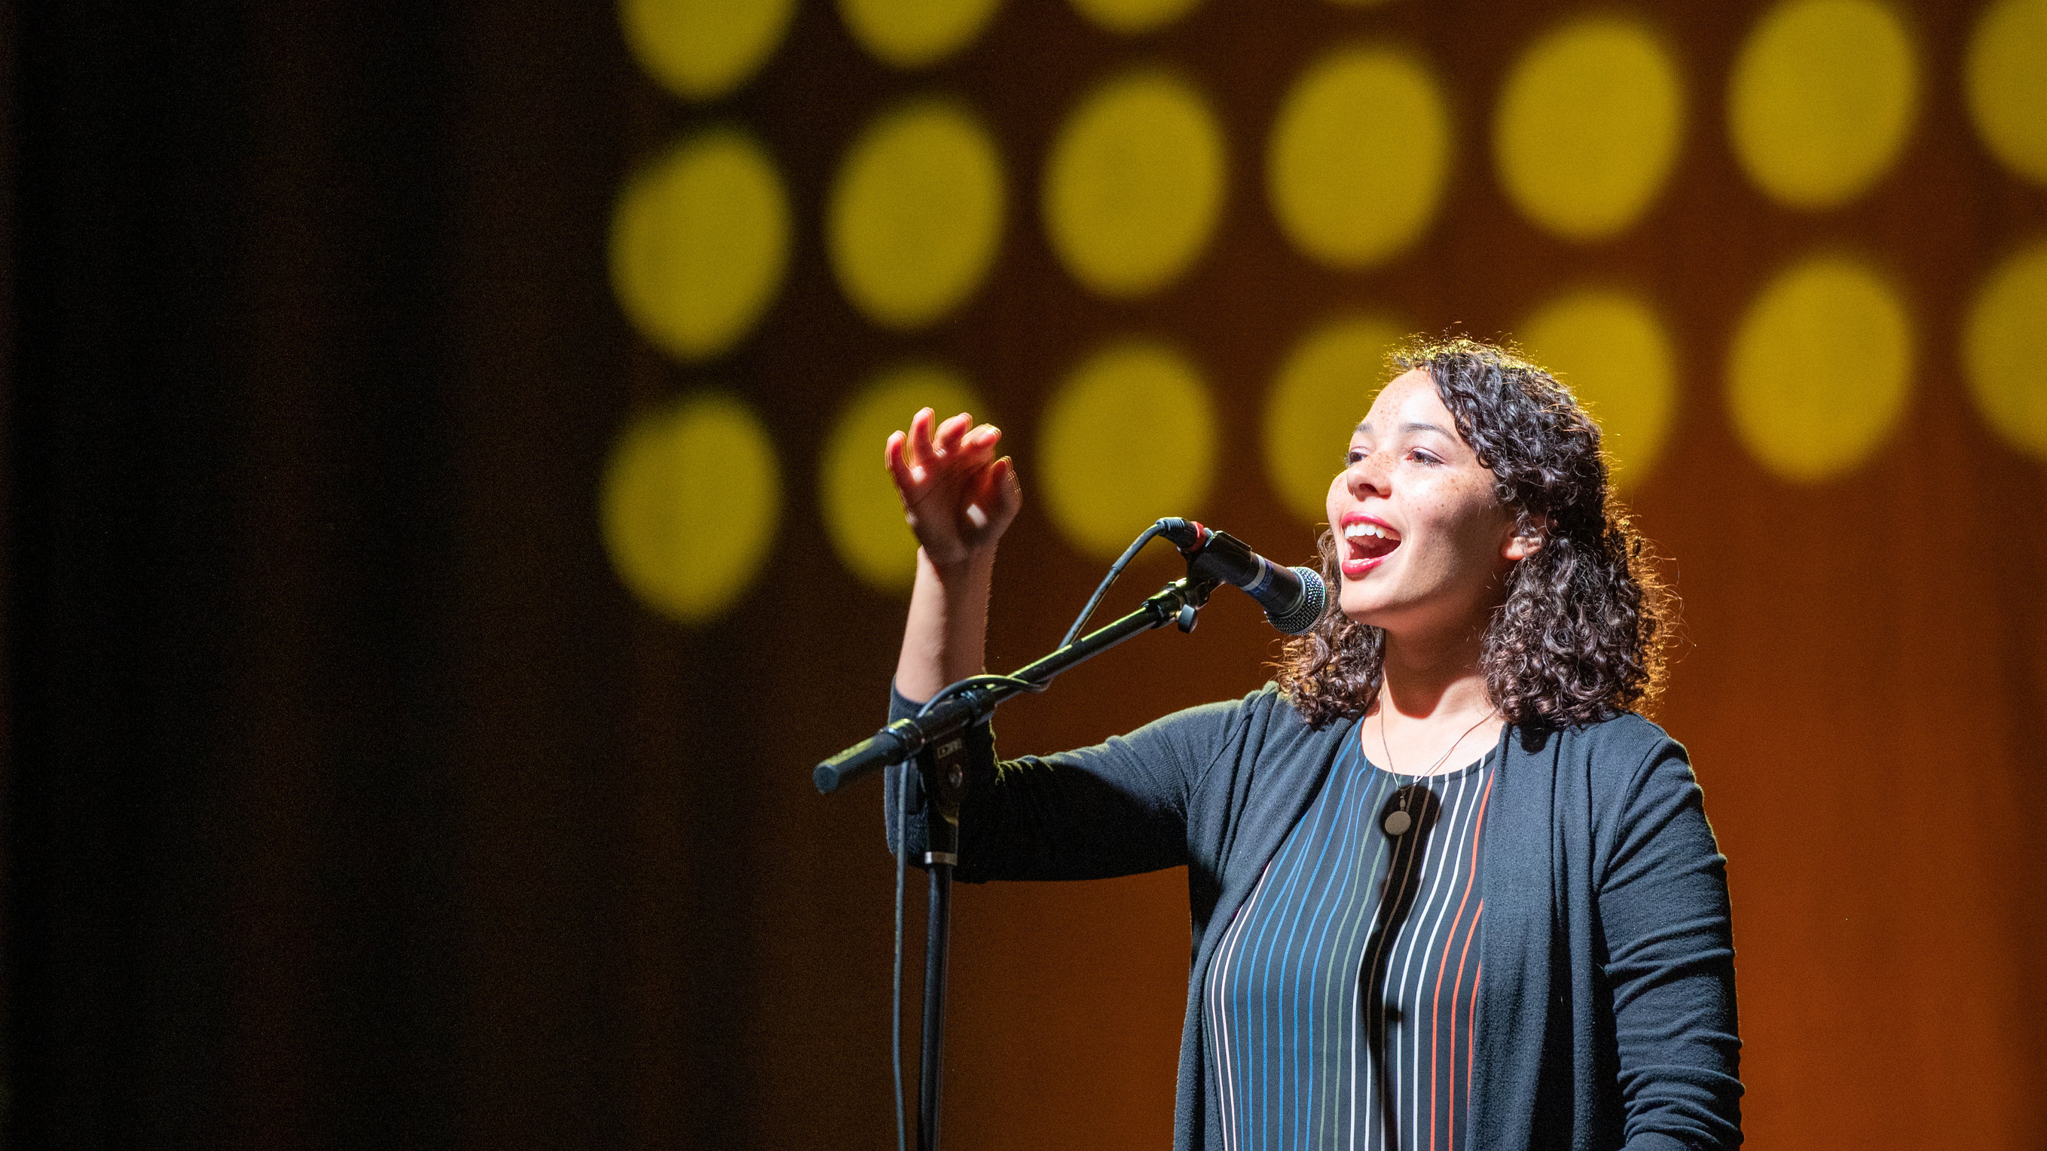
Registration opens March 1
convention.mennoniteusa.org
Kansas City, Mo.
July 3-6
Youth & Young Adult Climate Summit
July 7

