Slide 1
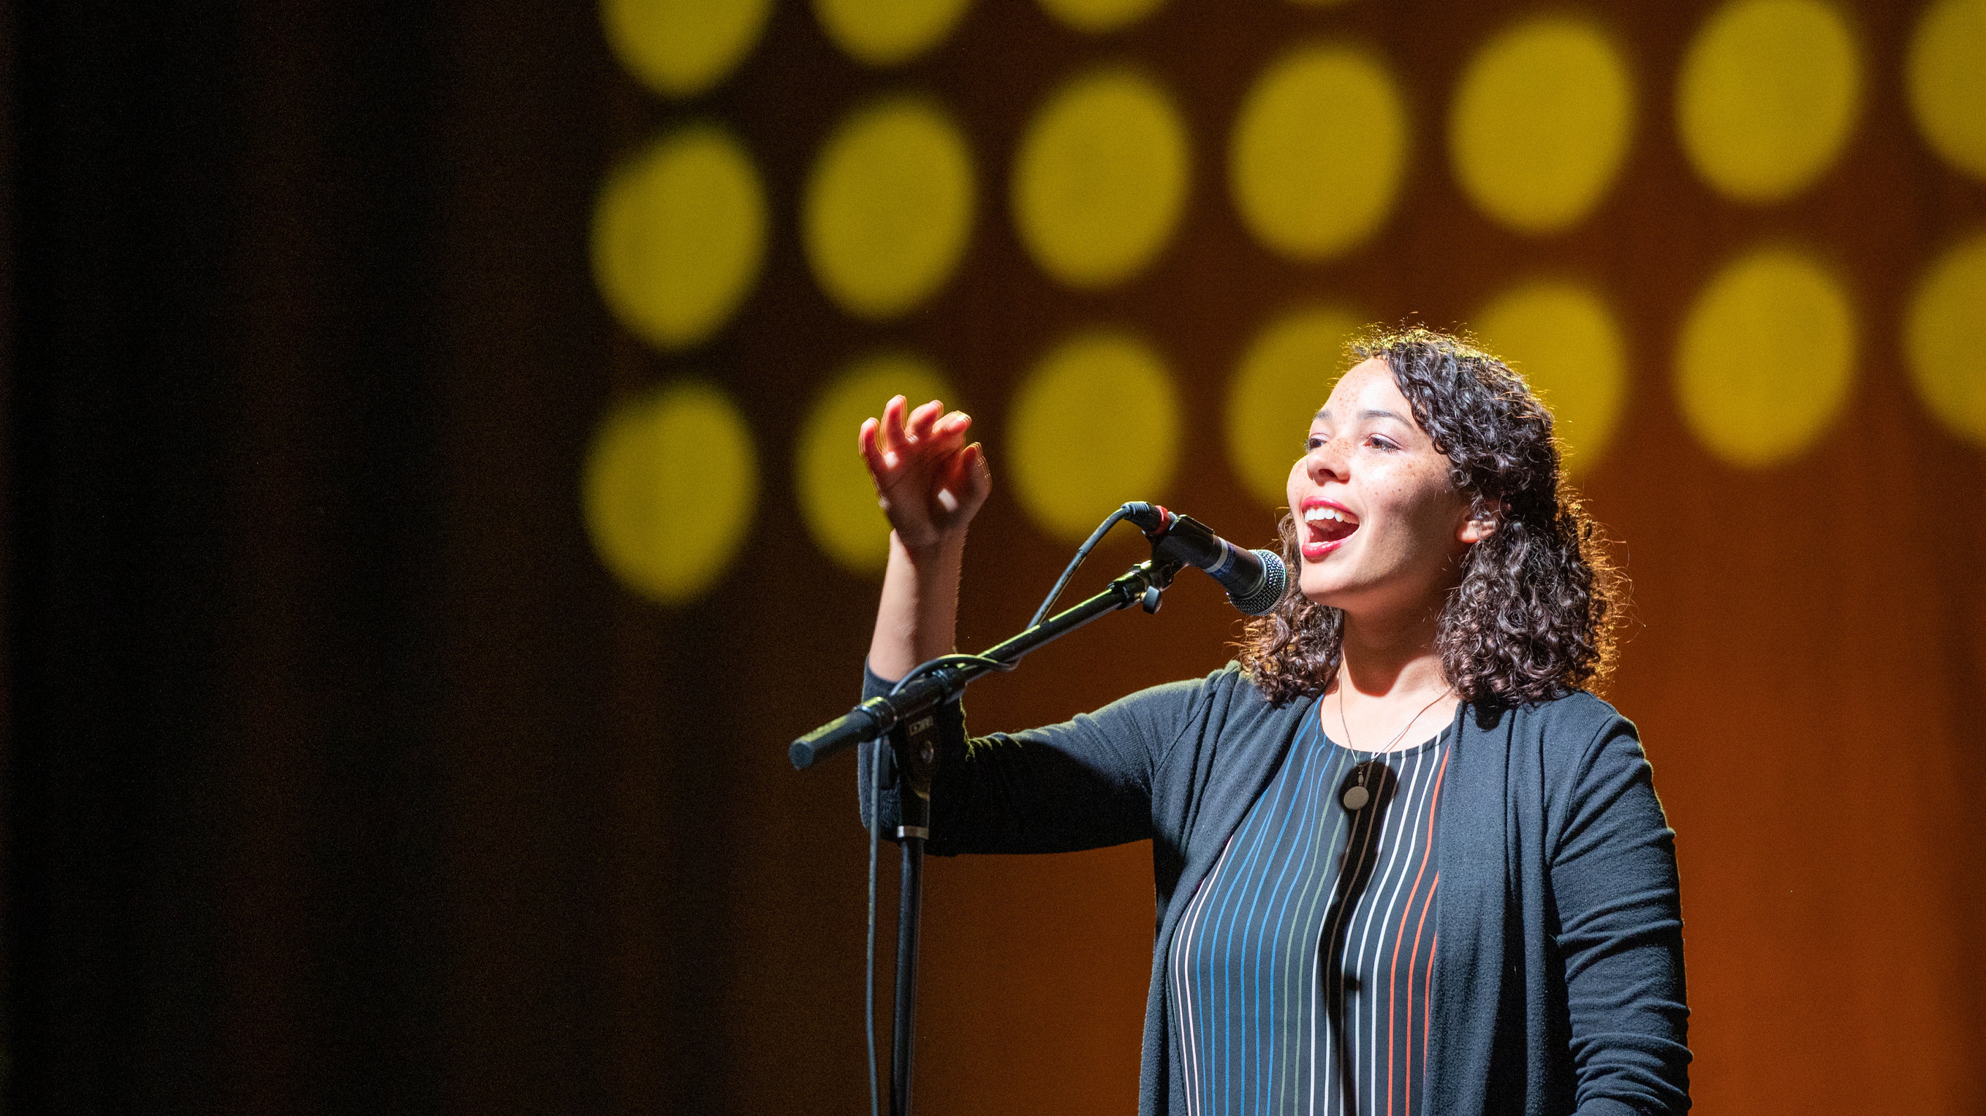
Early bird registration
ends May 14!
convention.mennoniteusa.org
Kansas City, Mo.
July 3-6
Youth & Young Adult Climate Summit
July 7

