Slide 1
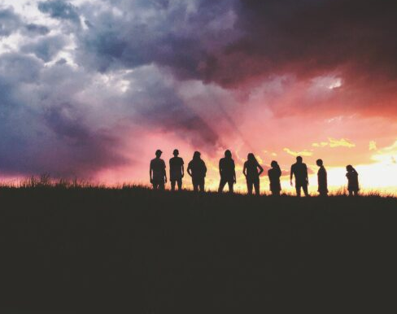
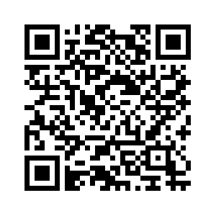
MC USA youth invited to participate in energy challenge
Register here!
The deadline to register is October 15, 2023.

